Slide 1
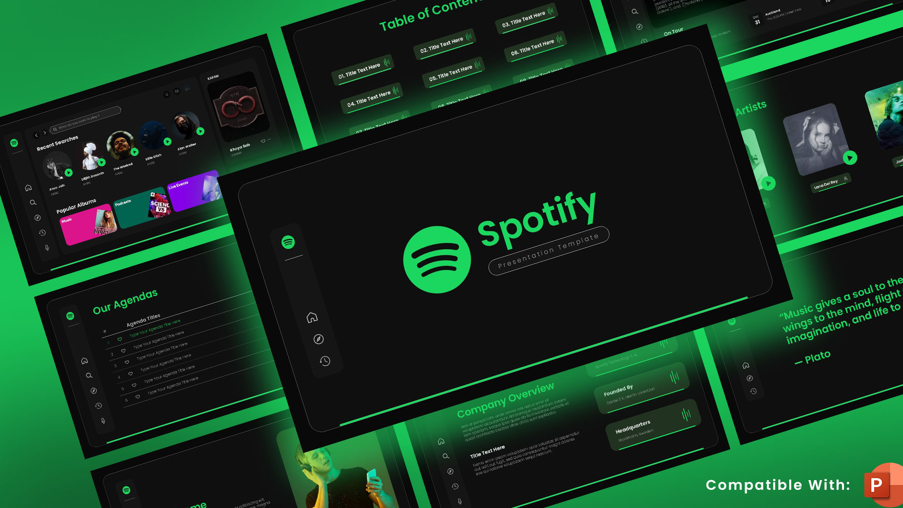
Unpacking Spotify: Clustering/Recommending Songs by Audio Traits
By Jessica W.

Slide 2
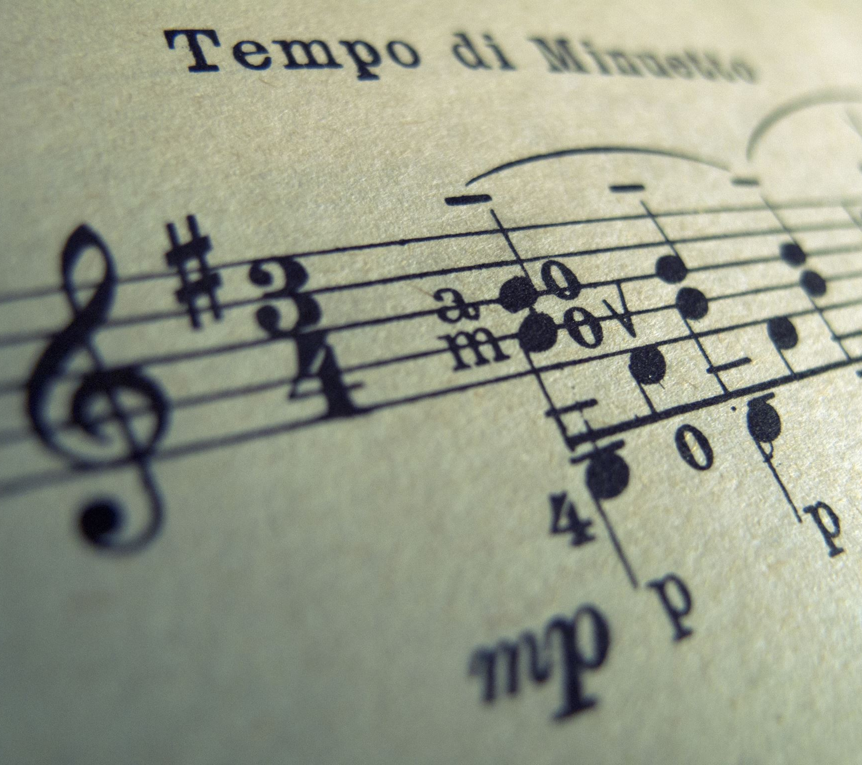
Project Goal
Moving beyond traditional genre labels, this project seeks to identify song similarities through clustering based on their audio features. By analyzing these distinct elements, and their combination, we aim to reveal nuanced relationships between songs that can provide a richer perspective on musical taste.

Slide 3
Dataset Overview
'track_name’,
'track_artist’,
'track_album_release_date’,
'playlist_genre’,
'playlist_subgenre’,
'danceability’,
'energy’,
'key’,
'loudness’,
'mode’,
'speechiness’,
'acousticness’,
'instrumentalness’,
'liveness’,
'valence’,
'tempo’,
'duration_ms’,
'language'

Slide 4
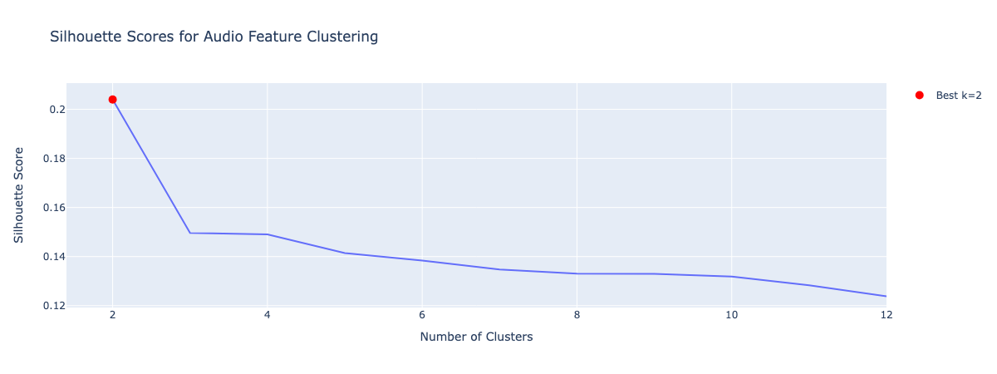
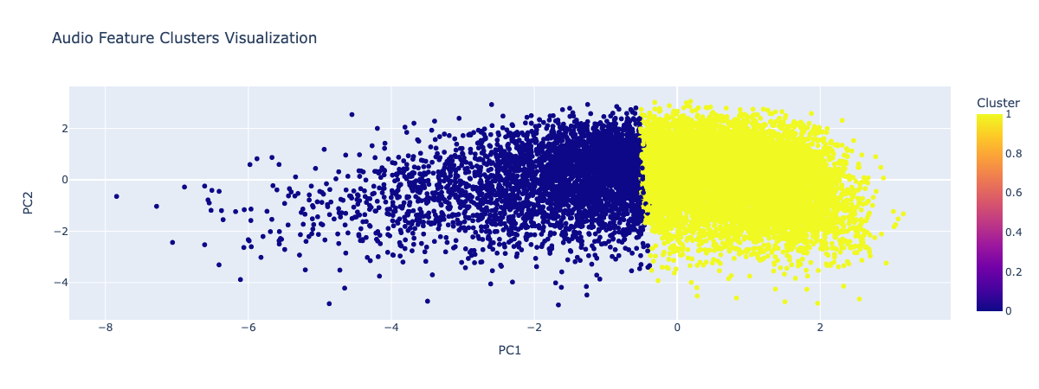
ML Approach Overview
K Means with only audio features
Excluded two features that have very low correlation with other features
(instrumentalness and speechiness)

Slide 5
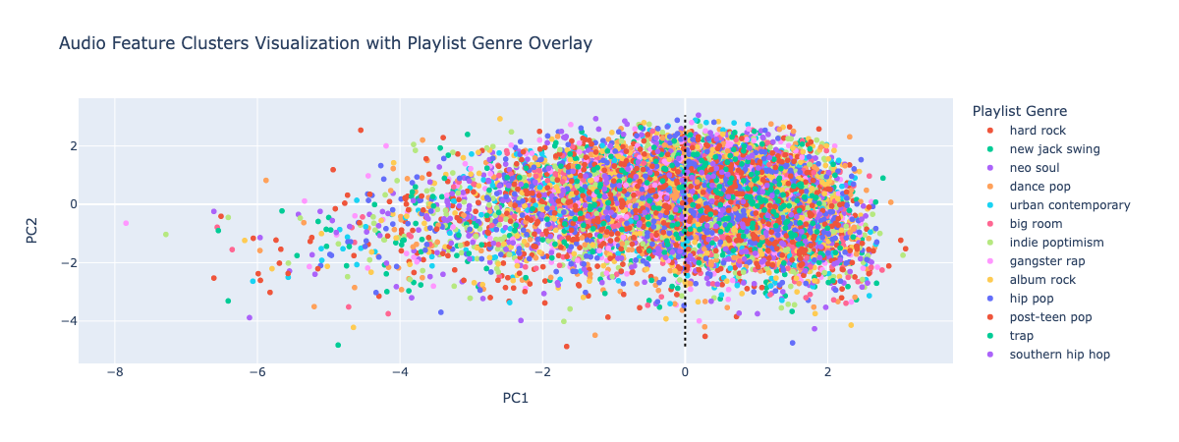
Genre Overlay For Potential Validation

Slide 6
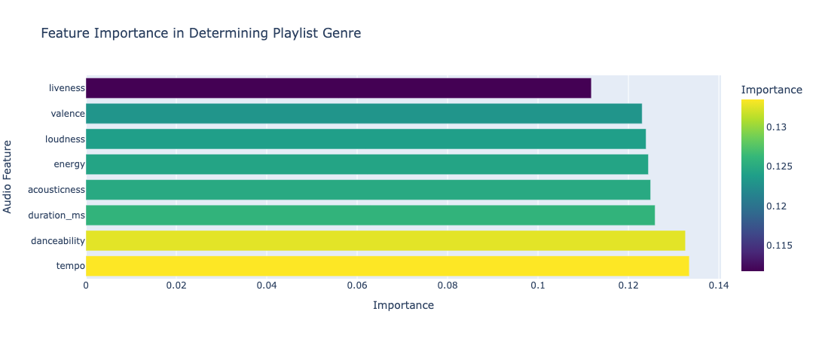
Methods Used

Slide 7
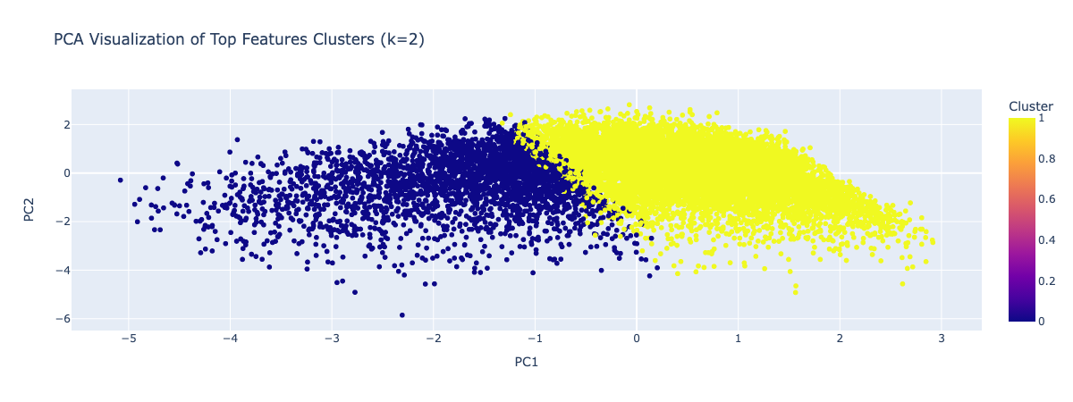
Improved Performance with Dimension Reduction

Slide 8
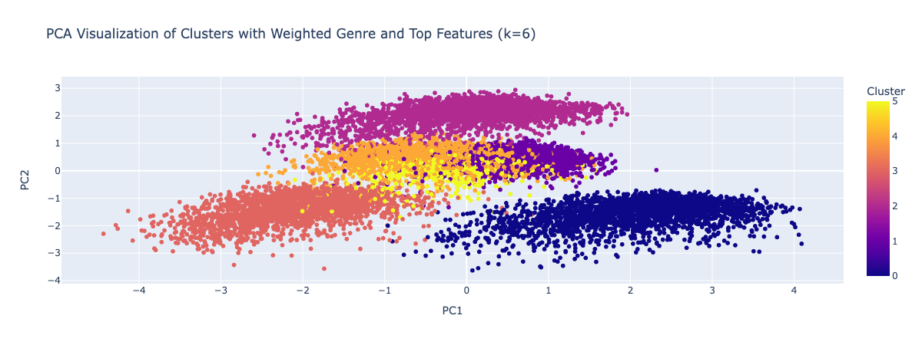
Weighted Genre and Top Feature Clustering

Slide 9
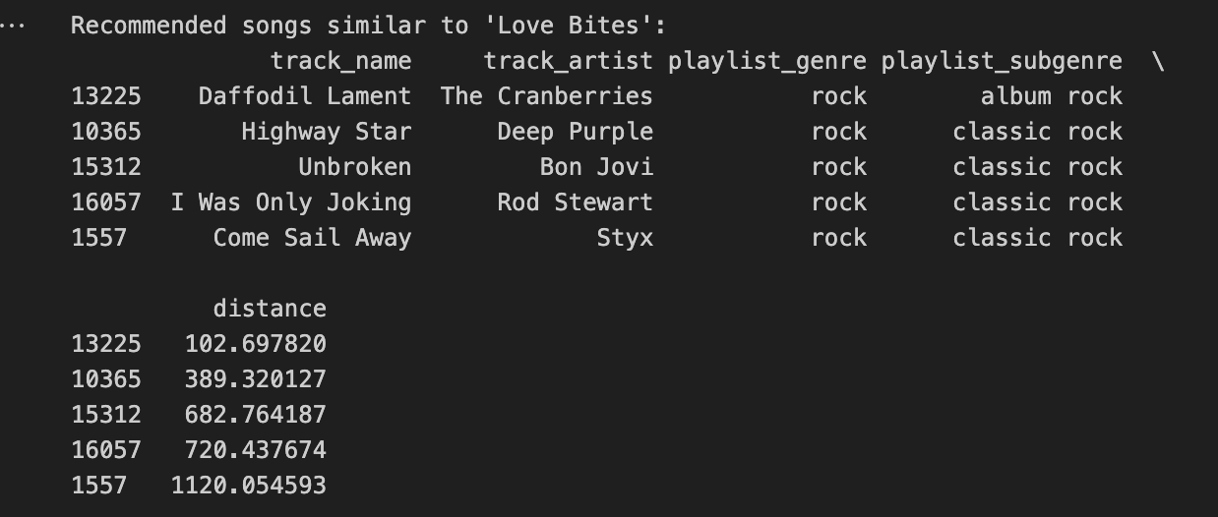
Song Recommender

Slide 10
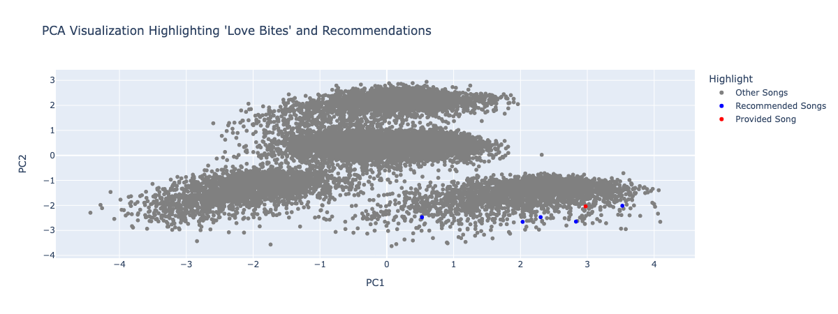
Graphical Representation

